Slide 1

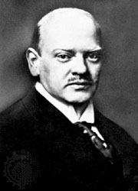
How the Republic was governed
Success of the party from 1924-1929
  Dawes Plan/Young Plan
  Impacts of the great depression
  Society during the Weimar Republic days

Slide 2

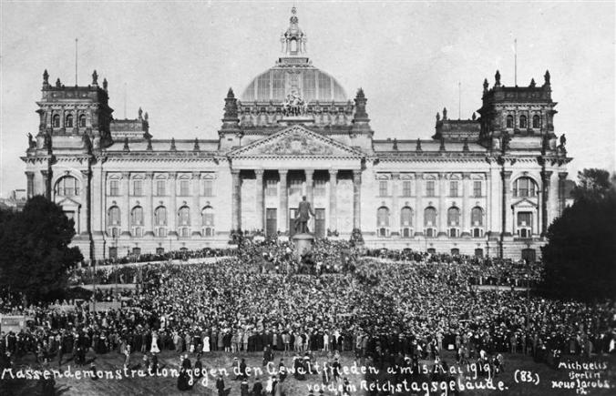
https://www.youtube.com/watch?v=QMK3Y0-DtPA

Slide 3
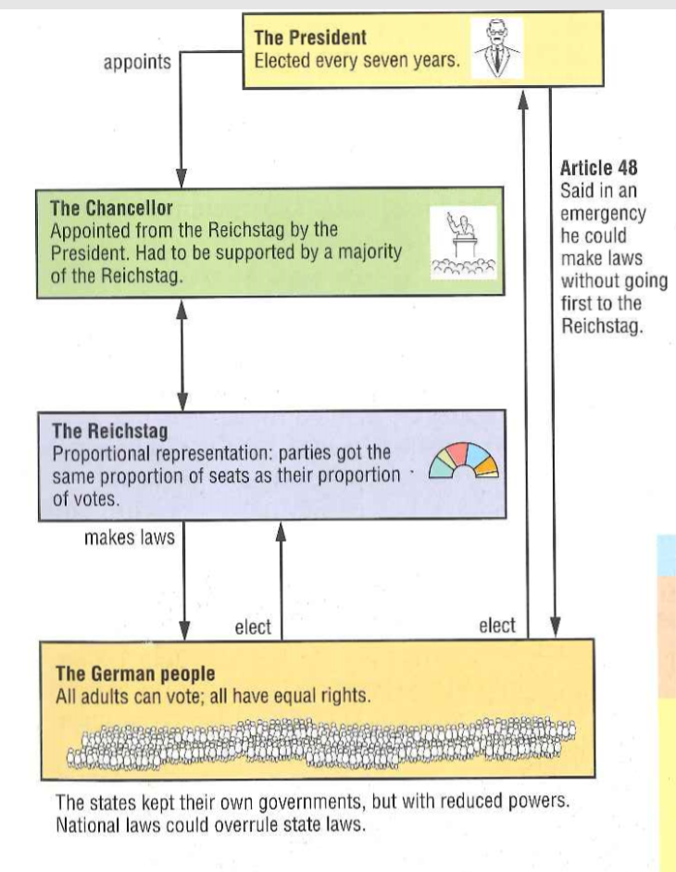

Slide 4

The period between 1924 and 1929 is known as a ‘Golden Age’ or ‘The Years of Hope’
Life became much calmer and more prosperous for Germany in these years
This was largely due to the policies of Stressemann
He improved Germany’s situation at home and abroad

Slide 5

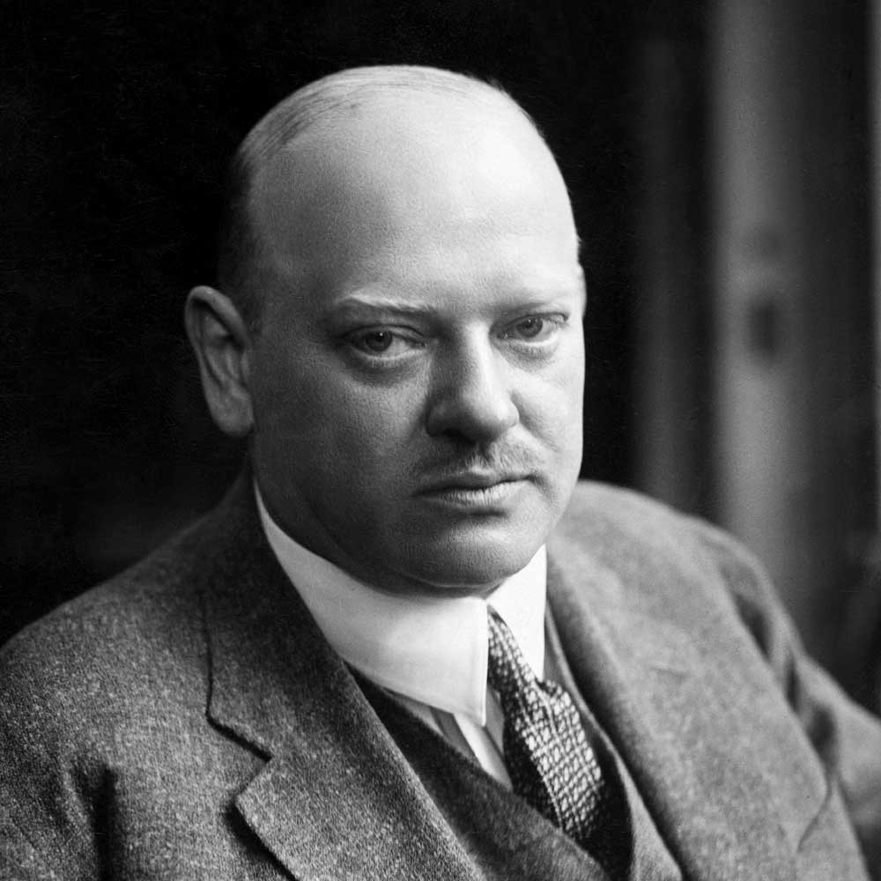
https://www.youtube.com/watch?v=gYc8fX527PQ

Slide 6

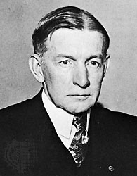
Domestic Improvements
Strikes were called off
Reparations were restarted
This led to help from the U.S
Dawes Plan 1924
Huge U.S loans helped to restart industry
Charles Dawes

Slide 7
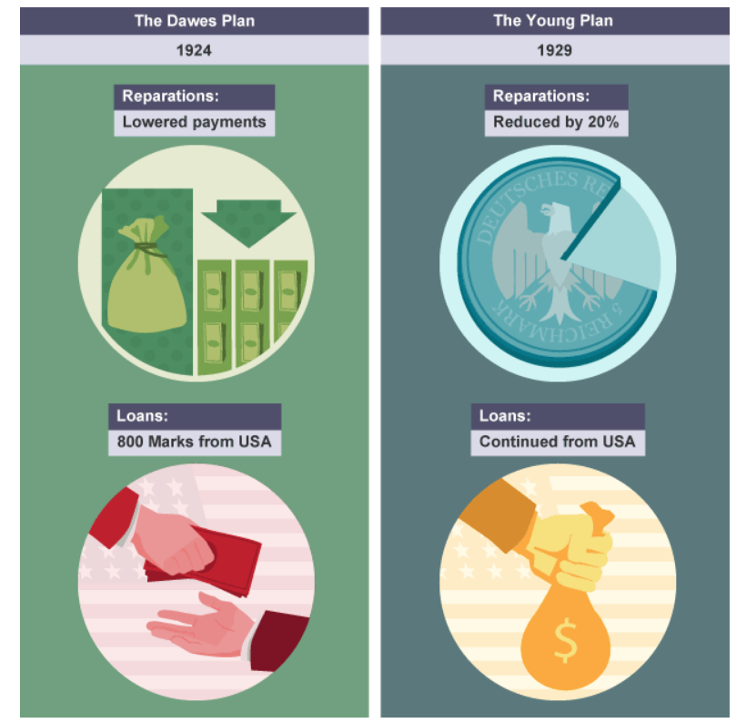

Slide 8
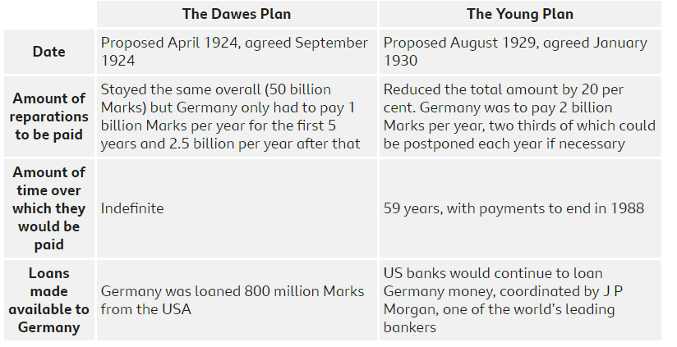

Slide 9
Stresemann introduced a new German Currency
The Rentenmark replaced the worthless mark
Its value was guaranteed by the U.S gold
This meant that Foreign businessmen could now invest in Germany’s economy
This led to an increase in new factories, industry, building work
Which led to employment

Slide 10

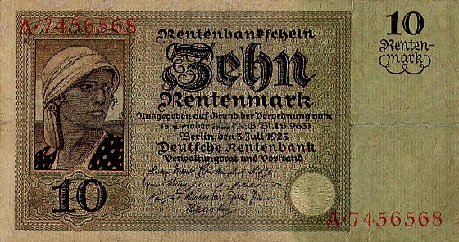
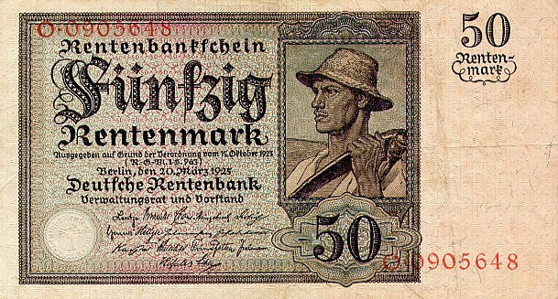

Slide 11

Stresemann regained trust and respect from other countries by…
Adhering to the Treaty of Versailles
Locarno Treaties 1925. In October 1925 Germany, France and Belgium agreed to respect their post-Versailles borders, whilst Germany agreed with Poland and Czechoslovakia to settle any border disputes peacefully. Germany had previously complained bitterly about their loss of territory.
Kellogg-Briand Pact 1928. Germany was one of 62 countries that signed up to this agreement, which committed its signatories to settling disputes between them peacefully.
Because of this Germany was invited to join The League of Nations in 1926

Slide 12
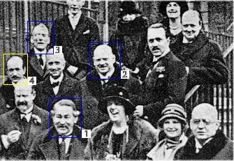
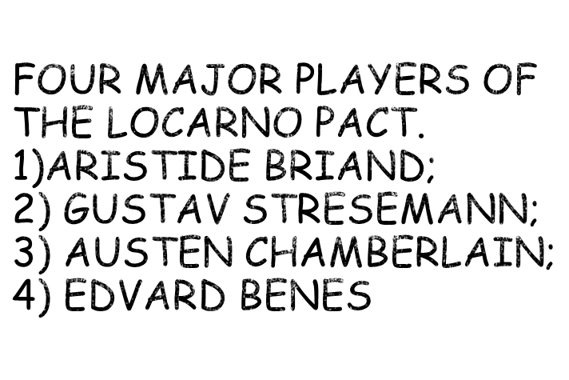
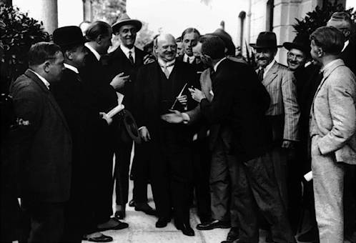
Stresemann congratulated and interviewed by journalists

Slide 13

Stresemann awarded the Nobel Peace Prize
Germany a much more prosperous and happy country than before the First World War
Weimar had its own distinct culture.

Slide 14

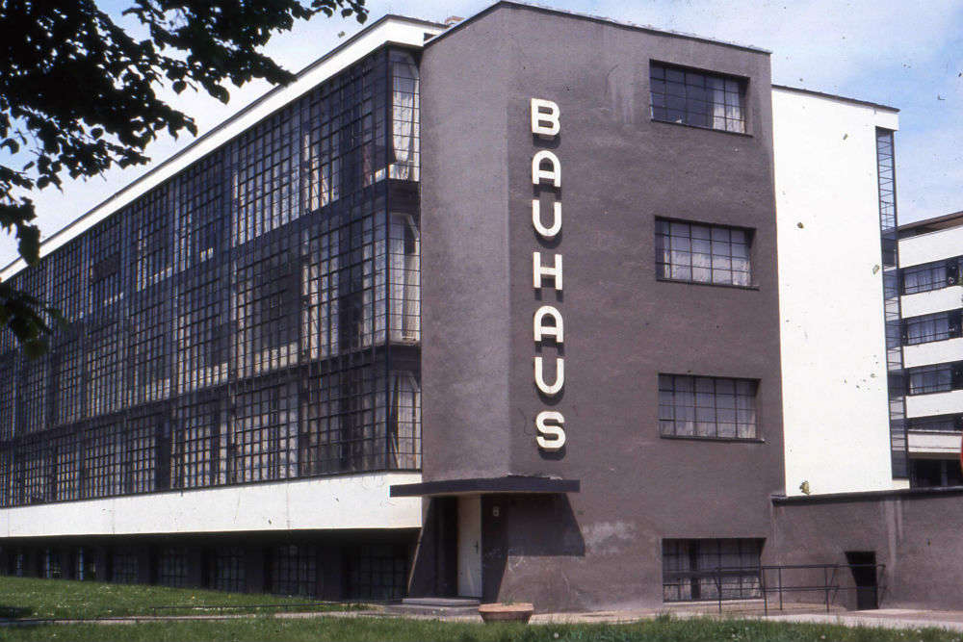
https://www.youtube.com/watch?v=4ls8SPpRXgU
architecture

Slide 15

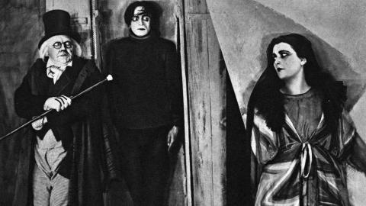

Slide 16

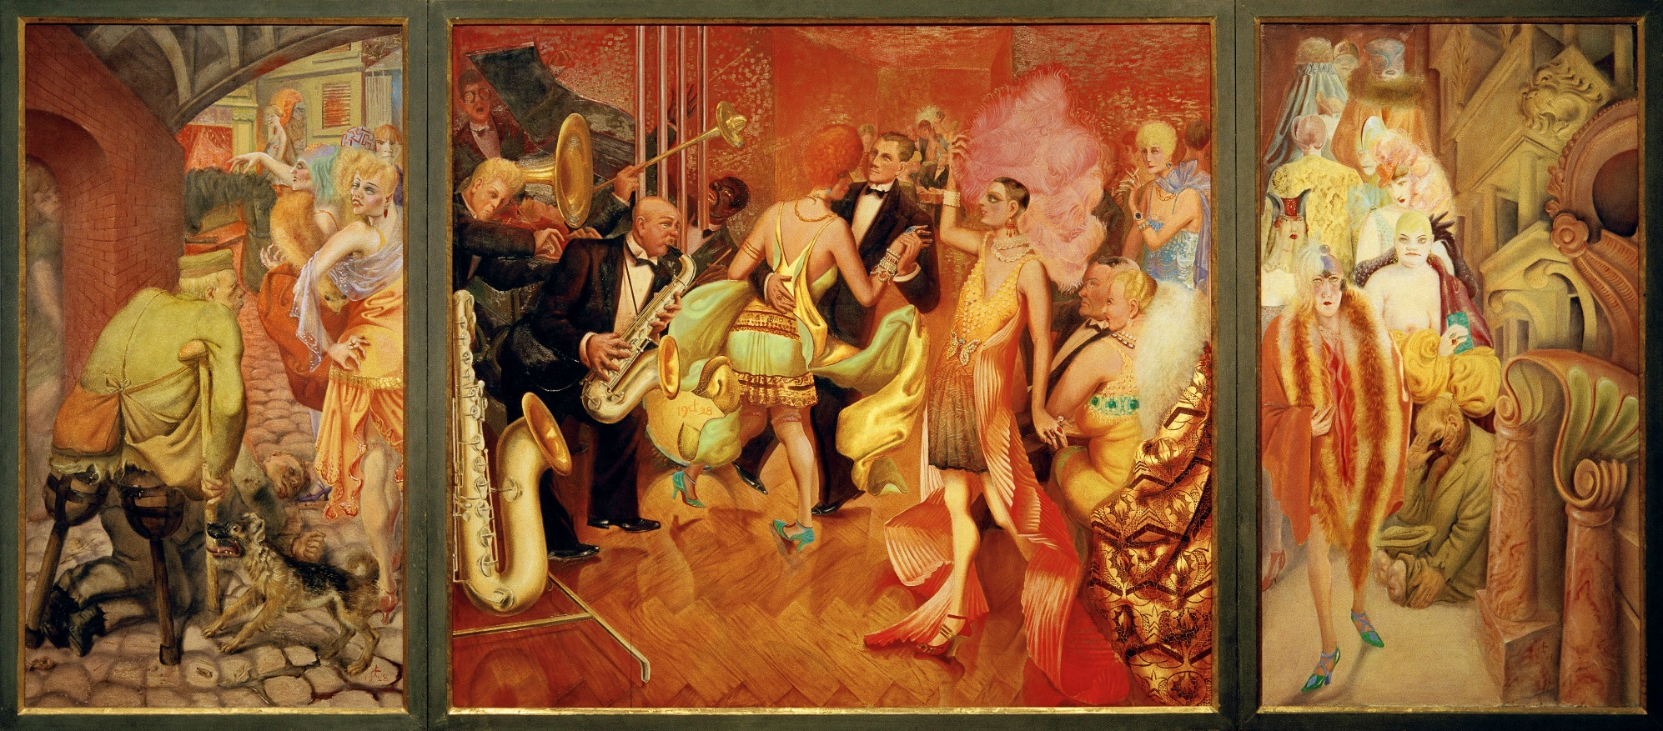

Slide 17
‘Life seemed more free, more modern, more exciting than in any place I have ever been…Everywhere there was an accent on youth. One sat up with young people all night in the pavement cafes, the plush bars, on a Rhineland steamer or in a smoke filled artist’s studio and talked endlessly abut life
. Most Germans one met struck you as being democratic, liberal, even pacifist. One scarcely heard of Hitler or the Nazis except as butts of jokes- usually in connection with the Beerhall Putsch as it came to be known’

